Slide 1







FY2025 Budget Planning:
Budget Foundation (Primer)
Agenda
2025 Budget Roadmap
Factors Influencing Budget Decisions:
  Demographic and Economic Factors
  Enrollment Factors
  Funding Factors
  Legislative Factors
Appendix
Engage. Inspire. Prepare.
Version 4.0
Based on the most current data available
March 13, 2024

Slide 2
FY2025 Budget Roadmap
March 12, 2024
Budget Foundation (Primer)
1 | Roadmap

Slide 3
Organizational Factors Influencing Decisions: Demographic and Economic Factors
“While Paulding County continues to have favorable employment and poverty levels, the school district continues to face challenges associated with a below-average tax digest-per-student resulting in limited local funding. As the side reflects, even after recovering from the Great Recession, we remain $1,060 or 26% lower than the average statewide local revenue per-pupil. This issue stems from enrollment growth, higher children-per-household ratios, and a limited commercial and industrial tax base – resulting in a tax digest disproportionally residential at 86%. The school district remains the largest employer and industry in Paulding County. We have seen a recent decline in building permits and residential sales, a short-term stabilization in home values, and a recent increase in days on the market.”
Demographic and Economic Factors:
Relatively low poverty percentage and unemployment rate
Largest employer and industry in county
Most workers employed outside the county
Limited commercial or industrial businesses, by land use and tax digest
Lower local revenue per student and net tax digest disproportionally residential (86%)
One of the fastest growing counties, with a significant number of school-age children
Recent decline in building permits and residential sales
Short-term stabilization in home values and a recent increase in days on the market
Engage. Inspire. Prepare.

Slide 4
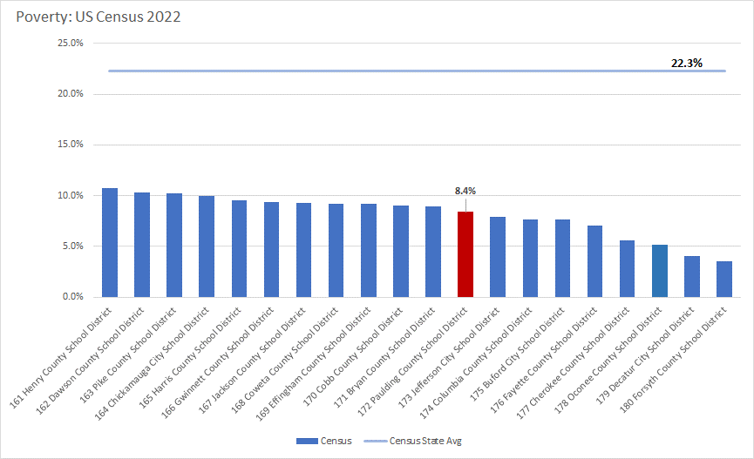

Poverty Level
Poverty Metrics. As of 2022, the most recent reporting period, with an 8.4% poverty percentage, the US Census ranked PCSD 172 (out of 180, 22.3% average).
2022
2 | Budget Factors

Slide 5
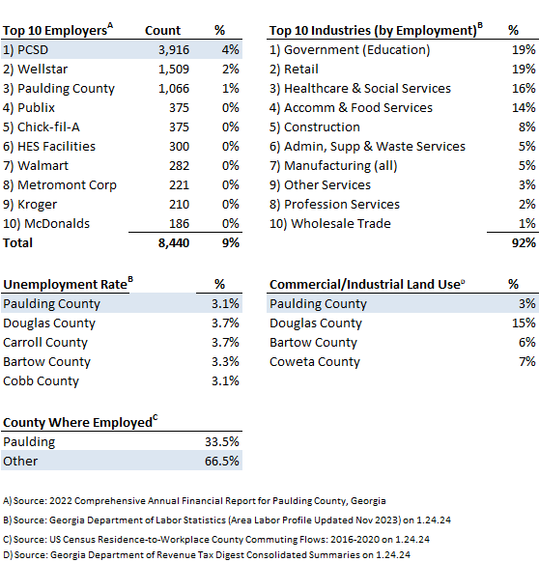
Employment and Land Use
Employment.
PCSD is the largest employer and represents the largest industry in Paulding County. The county maintains a relatively low unemployment rate, with most workers employed outside the county.
Land Use.
Only a small percentage of land in Paulding County is used for Commercial or Industrial Purposes.
Various
2 | Budget Factors

Slide 6
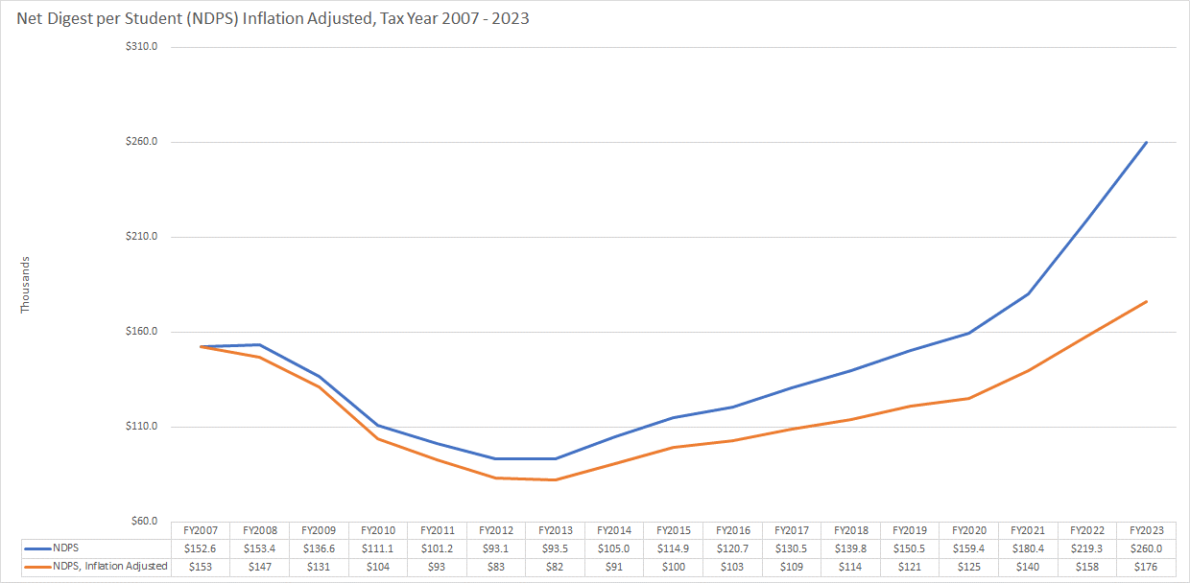
Tax Digest and the Great Recession
Net Digest. As of FY2023, the Net Digest per Student (NDPS) had increased 15.0% from FY2007, inflation adjusted. This is significant to note because the District has been recovering from the Great Recession and approximately one-third of the District's revenues comes from local sources.
Source: Bureau of Labor Statistics, CPI Calculator (measured in January, annually) and Georgia Department of Revenue, Consolidated Tax Digest Summary
FY2007 – FY2023
2 | Budget Factors

Slide 7
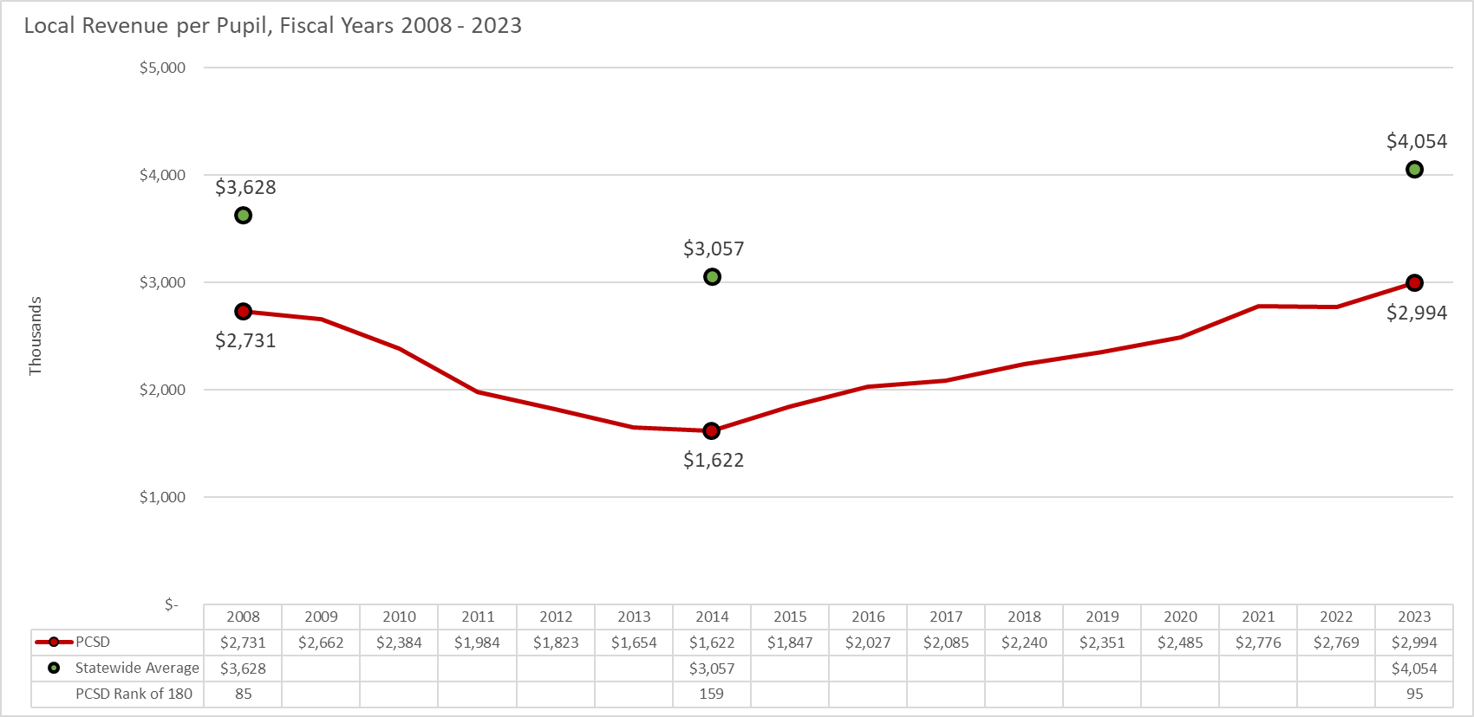
Local Revenue per Pupil
Local Revenue per Pupil. As of FY2023, Local Revenue per Pupil had increased 9.6% from FY2008 compared to a Statewide average of 11.7%, inflation adjusted. As of FY2023, the District was $1,060 or 26.2% lower than the Statewide average, a $33.5 million deficit. This is significant given approximately one-third of the District's revenues comes from local sources.
Source: GaDOE School System Revenue/Expenditures Report as of FY2023
FY2008 – FY2023
2 | Budget Factors

Slide 8
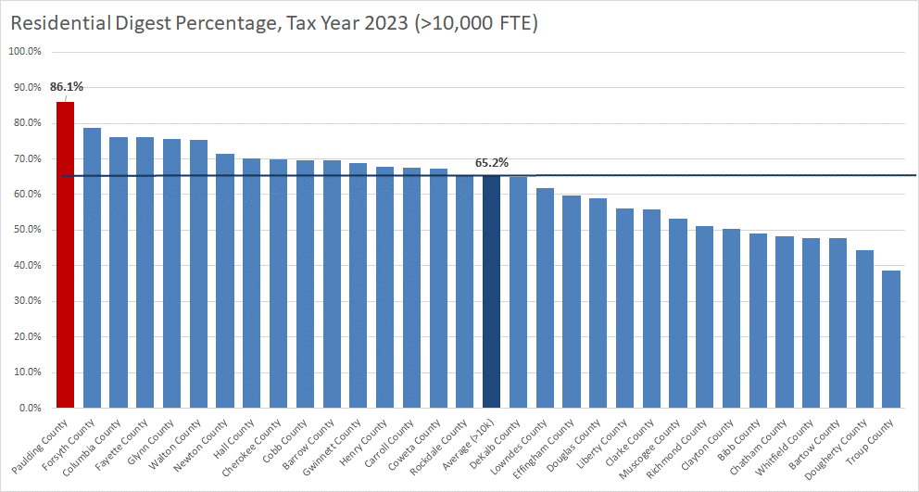
Residential Digest Percentage
Residential Digest Percentage. As of 2023, Paulding County had the highest percentage of the digest considered residential at 86.1%, compared to a large district average of 65.2%.
2023
2 | Budget Factors

Slide 9
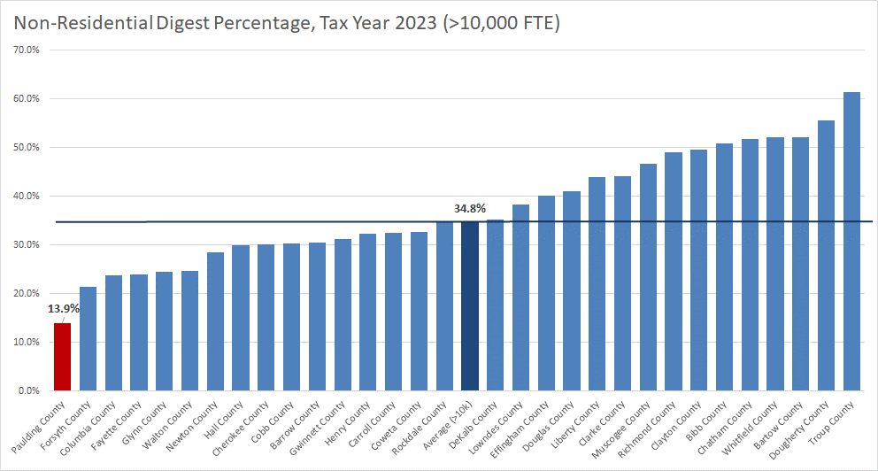
Non-Residential Digest Percentage
Non-Residential Digest Percentage. Conversely, as of 2023, Paulding County had the lowest percentage of the digest considered non-residential at 13.9%, compared to a large district average of 34.8%.
2023
2 | Budget Factors

Slide 10
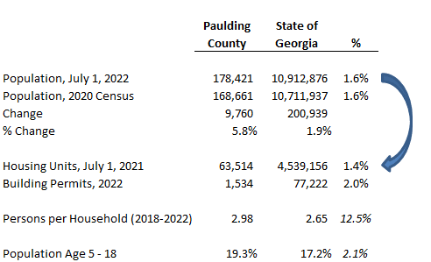
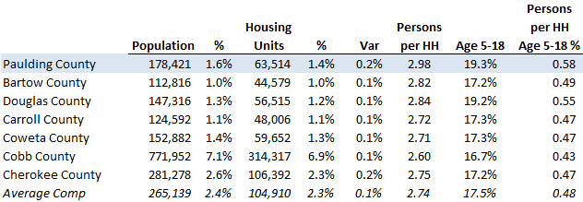
Population Growth and School-Age Children
Population Growth. Paulding County is one of the fastest growing counties in Georgia.
School-age Children. Tax digest issues are exacerbated by the high number of school-age children per household in Paulding County, as there is not a correlating increase in local funding, which is based on property tax values not the number of school-age children living in the home.
Source: http://www.census.gov/quickfacts on 1.24.24
Large Districts are districts with >10,000 FTE
2022
2 | Budget Factors

Slide 11
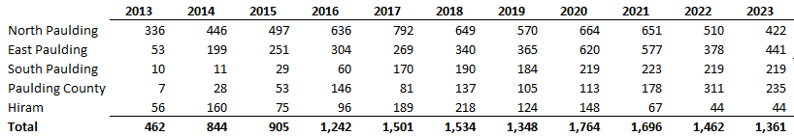
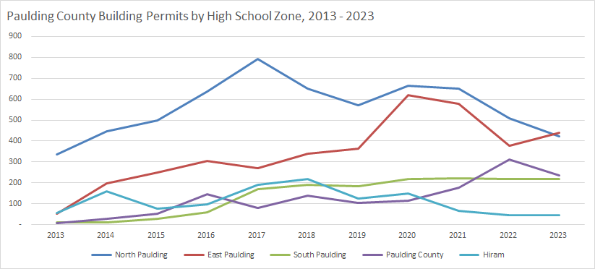
Building Permits
Building Permits. In 2020, Paulding County issued 1,764 building permits. By 2023, 1,361 were issued, with most of the growth clustering around North and East Paulding County.
Source: Paulding County Economic Development and Paulding County Chief Appraiser
FY2010 – FY2021
FY2013 – FY2023
2 | Budget Factors

Slide 12
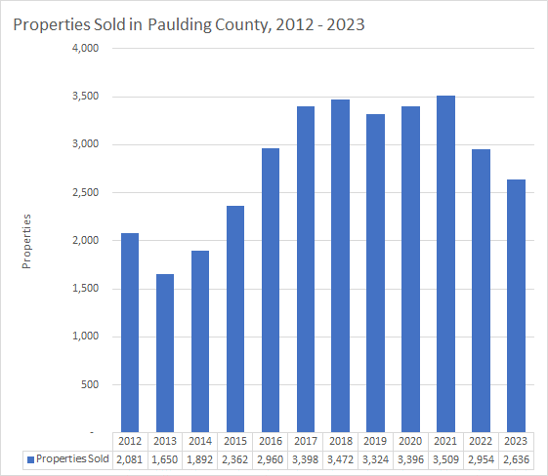
Residential Home Sales
Residential Home Sales. Over 2,600 properties sold in 2023, a decrease of 318 or -10.8% over the prior year.
2023 represents an increase of 555 or 26.7% over 2012.
Source: Paulding County Chief Appraiser
2012 – 2020
2012 – 2023
2 | Budget Factors

Slide 13
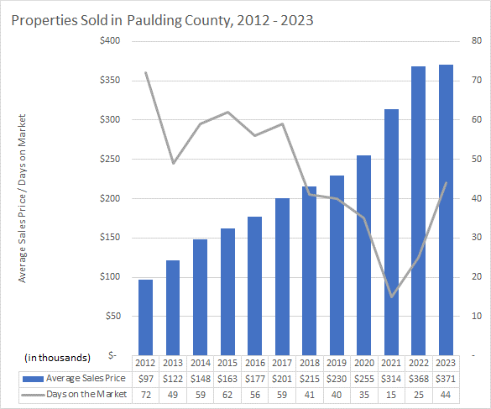
Residential Home Sales
Average Sales Price. The average sales price in 2023 was $370,895 an increase of $2,993 or 0.8% over the prior year.
Days on the Market. In 2023, the average number of days on the market increased 19 days or 76.0% to 44 days.
Source: Paulding County Chief Appraiser
2012 – 2020
2012 – 2023
2 | Budget Factors

Slide 14
Organizational Factors Influencing Decisions: Enrollment Factors
“Paulding County School District is one of the largest, fastest-growing, and low-wealth school districts in Georgia. As you see on the slide, the district remains the 11th largest school district in the state of Georgia and over the prior three years, we were the 8th fastest growing large district in Georgia. The latest demographic studies strongly suggest that this growth momentum will continue for the next 5 to 10 years, outpacing comparable districts in the region. Current FY2025 projections reflect an increase of 344 students or 1.1% to 31,935. Over the prior 10-years the district has grown 3,317 or 11.7%.”
Enrollment Factors:
With 31,591 students, ranked as the 11th largest district in the state of Georgia
Enrollment rank is 7th out of 15 comparable districts (20k-60k)
3-year annual growth rate of 2.0%, 8th highest of the 37 large districts in Georgia
FY2025 projections reflect an increase of 344 students or 1.1% to 31,935
Over the prior 10-years the district has grown 3,317 or 11.7%
15.6% of students are enrolled in an ESEP program
Engage. Inspire. Prepare.

Slide 15
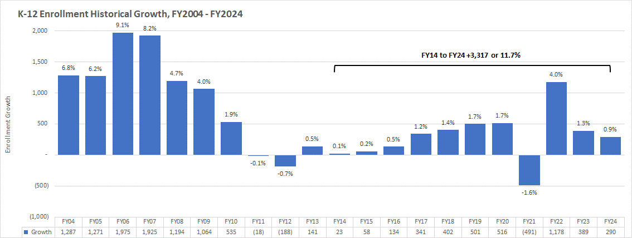
Historical Growth
K-12 Enrollment Historical Growth. For the 10 years ending FY2024, the district had an annual growth rate of 1.1%. FY2014 to FY2024 enrollment increased 3,317 or 11.7%. FY2024 enrollment increased 290 or 0.9% to 31,591. Preliminary FY2025 projections reflect an enrollment increase of 344 or 1.1% to 31,935.
Source: GaDOE (Student Enrollment by Grade)
FY2004 – FY2024
2 | Budget Factors

Slide 16
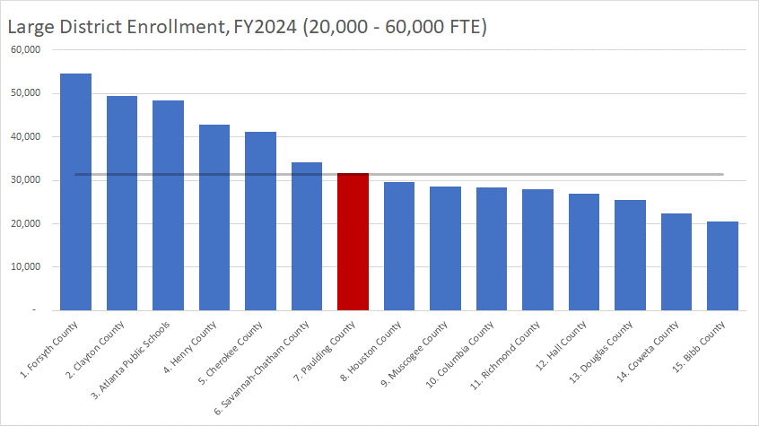
Enrollment Growth
20,000 to 60,000 Comp Enrollment As of October 2023, PCSD was the 7th largest school district in Georgia (out of districts with 20,000 to 60,000 enrollment).
Source: GaDOE (Student Enrollment by Grade)
FY2024
2 | Budget Factors

Slide 17
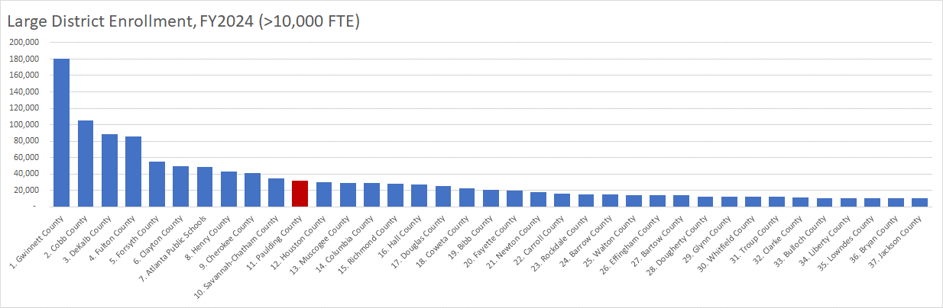
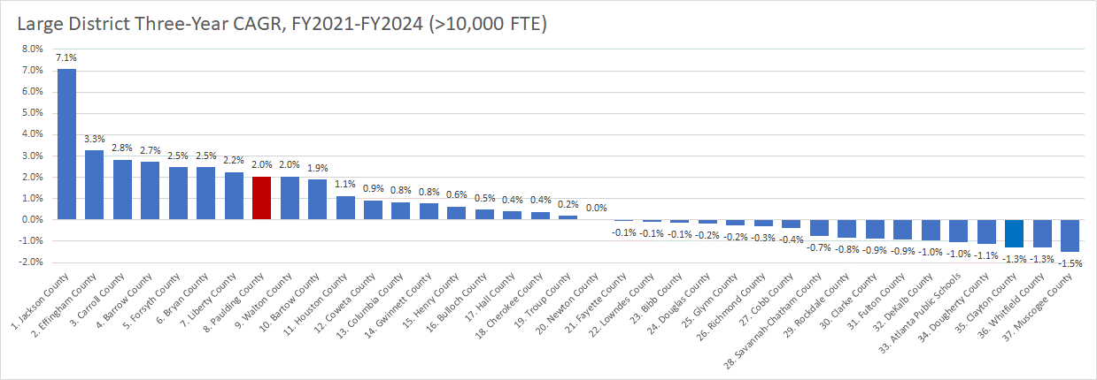
Enrollment Growth
Large District Enrollment As of October 2023, PCSD was the 11th largest school district in Georgia (out of the 180 districts and 37 large districts).
Source: GaDOE (Student Enrollment by Grade), Large Districts are districts with >10,000 FTE
FY2021- FY2024
2 | Budget Factors

Slide 18
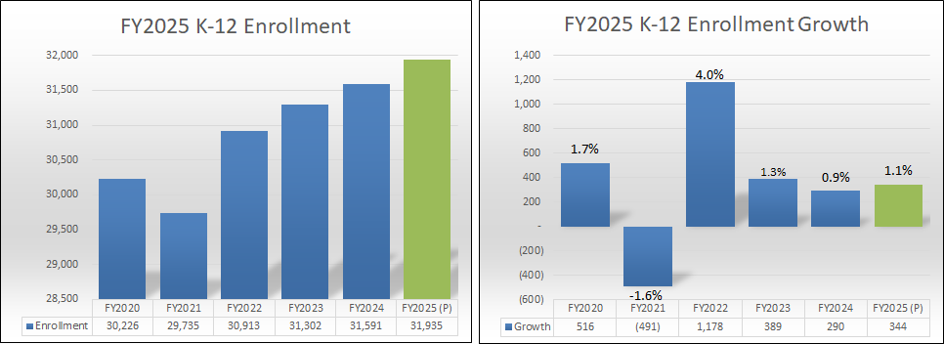
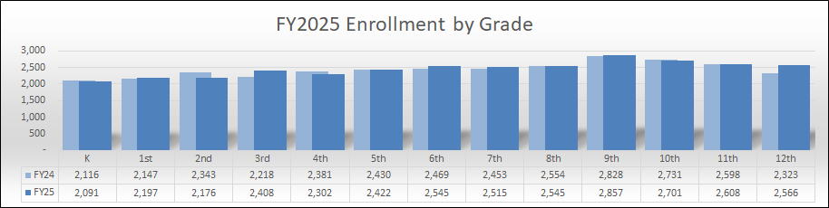
Preliminary Enrollment
Please Note: These are preliminary numbers and will be influenced by Kindergarten Registration, School Choice, Programs, etc.
FY2025 (P)
2 | Budget Factors

Slide 19
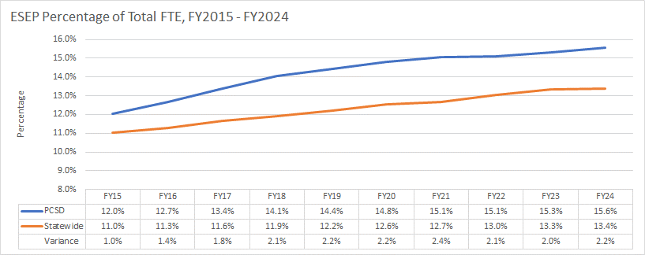
ESEP Participation
ESEP Participation. In FY2024, enrollment in Exceptional Students Educational Programs (ESEP) was 15.6% of the student population, compared to a statewide and large district average of 13.4% and 13.3%, respectively.
From FY2015 to FY2024, the district, statewide and large district participation percentage increased 3.6%, 2.4% and 2.3%, respectively.
Source: GaDOE Enrollment by Disability and Student Enrollment by Grade as of FY2024 (includes PK)
Large Districts are districts with >10,000 FTE
FY2015- FY2024
2 | Budget Factors

Slide 20
Organizational Factors Influencing Decisions: Funding Factors
“Due to the factors previously mentioned, including a significantly lower non-residential digest percentage of 14% and a comparable millage rate to other large and neighboring school districts, our local revenue per pupil is expected to remain significantly lower than that of other large and comparable districts. We remain the 4th largest recipient of the Equalization Grant (7% of our total revenue), which will provide some relief through state revenue. Out of 16 comparable districts (20k-60k) we rank 12th in local revenue per-pupil and 2nd in state revenue per-pupil. Compared to all 180 school districts, we rank 95th in local revenue per-pupil and 98th in state revenue per-pupil, while being the 11th largest school district in Georgia. Looking at Local and Total Revenue on the left side of the slide, we currently collects $0.90 for every $1.00 in total revenue per student statewide (average) and $0.74 for every $1.00 in local revenue per pupil statewide (average). When it comes to SPLOST Collections, we currently collects only $0.55 for every $1.00 collected on average by our neighboring school districts, including Cherokee, Cobb, Bartow, and Douglas Counties. Considering Debt Service, we only $0.41 for every $1.00.”
Funding Factors:
57% of revenue comes from state sources, compared to a statewide average of 45%
Local revenue per-pupil rank is 12th out of 16 comparable districts (20k-60k)
State revenue per-pupil rank is 2nd out of 16 comparable districts (20k-60k)
Total revenue per-pupil rank is 10th out of 16 comparable districts (20k-60k)
4th largest recipient of the Equalization Grant, 7% of total revenue
Millage rate of 17.675 is comparable to large district average of 17.534
Low Title I funding per-pupil, ranked 12th out of 16 comparable districts (20k-60k)
Engage. Inspire. Prepare.

Slide 21
Revenue Sources
Dependency on State Sources. With approximately 57% of revenue coming from state sources (compared to a statewide average of 45%) the District is highly susceptible to changes in state funding, including austerity reductions, Equalization Grant funding and changes in the Quality Basic Education (QBE) formula.
FY2022
Source: GaDOE School System Revenue/Expenditures Report as of FY2023
FY2023
2 | Budget Factors

Slide 22
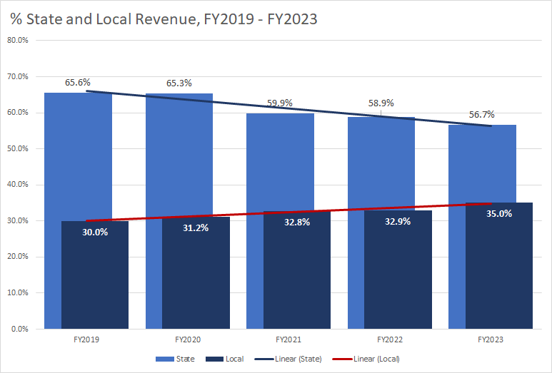
Revenue Sources Trend
% State and Local Revenue Trend. From FY2019 to FY2023, the percentage of revenue from state sources has decline from 65.6% to 56.7%, while the percentage of revenue from local sources has increased from 30.0% to 35.0%.
Source: GaDOE School System Revenue/Expenditures Report as of FY2023
FY2019 – FY2023
2 | Budget Factors

Slide 23
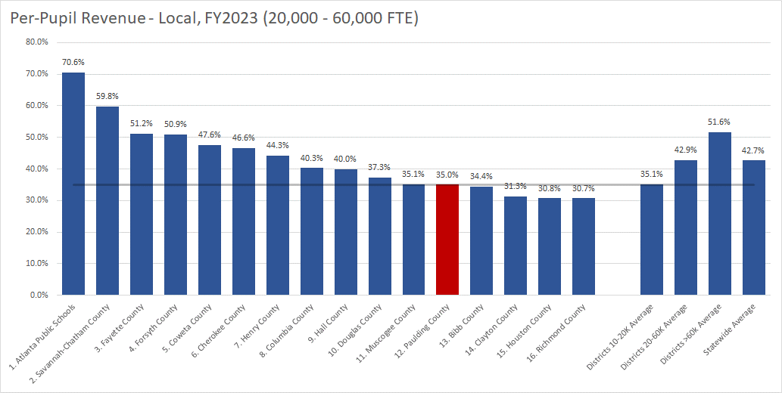
Per-Pupil Revenue: Local
Local Per-Pupil Revenue. As of FY2023, local per-pupil revenue was 35.0% of total revenue. This is lower than most comparable groups, including the statewide average of 42.7%.
Source: GaDOE School System Revenue/Expenditures Report as of FY2023
FY2023
2 | Budget Factors

Slide 24
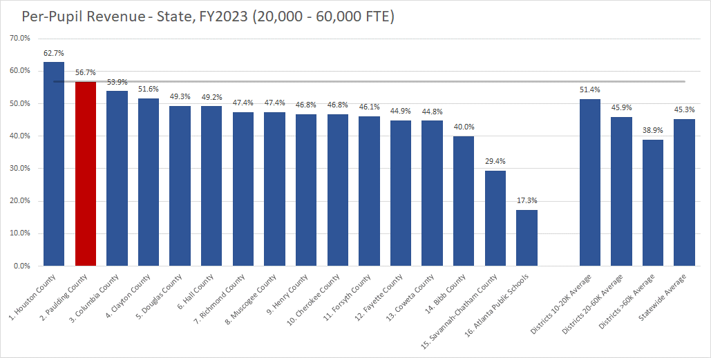
Per-Pupil Revenue: State
State Per-Pupil Revenue. As of FY2023, state per-pupil revenue was 56.7% of total revenue. This is higher than any comparable group, including the statewide average of 45.3%.
Source: GaDOE School System Revenue/Expenditures Report as of FY2023
FY2023
2 | Budget Factors

Slide 25
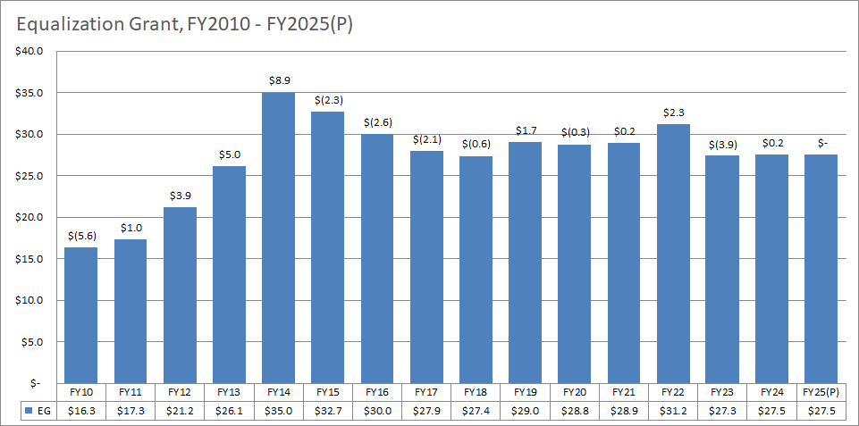
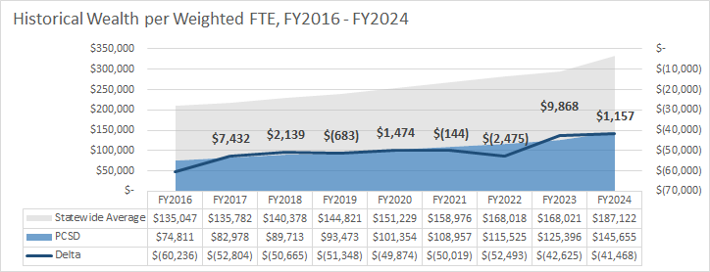
(2) Equalization Grant
Equalization Grant. The Equalization Grant accounts for 7% of total revenue.
A decreasing (unfavorable) variance between PCSD and Statewide Wealth-per-Weighted FTE has result in a grant decrease and limited growth.
(millions)
FY2010 – FY2025 (P)
3 | GF Revenue

Slide 26
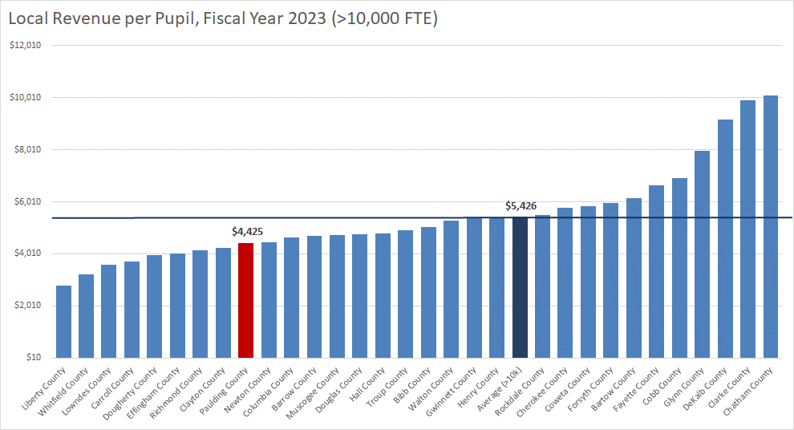
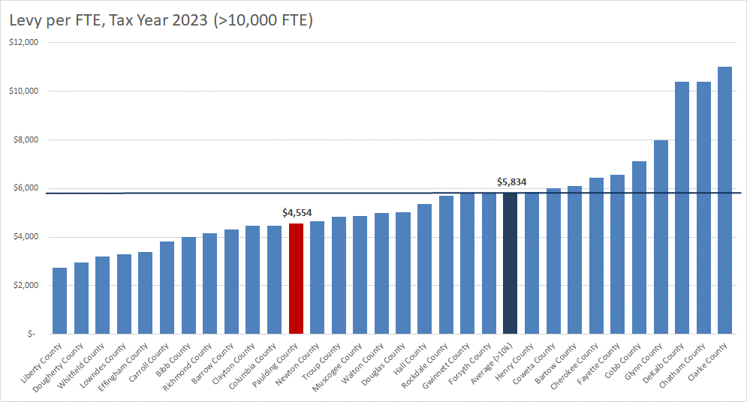
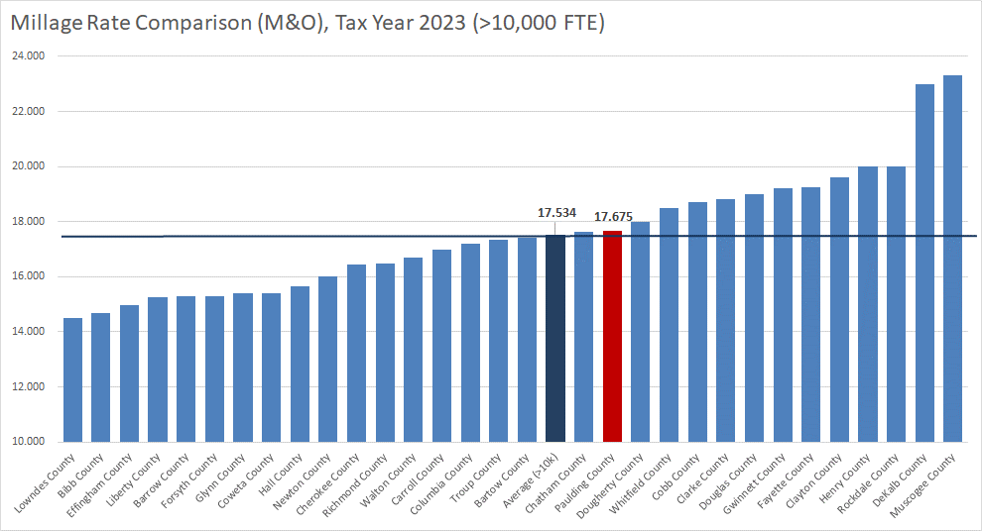
Local Revenue: Property Tax
Local Revenue Metrics. Among large district, PCSD ranked lowest in non-residential digest percentage, had an average millage rate, and ranked 12th lowest in levy per FTE.
Source: GaDOR (Consolidated Tax Digest Summaries)
Large Districts are districts with >10,000 FTE
2023
4 | Comparable Districts

Slide 27
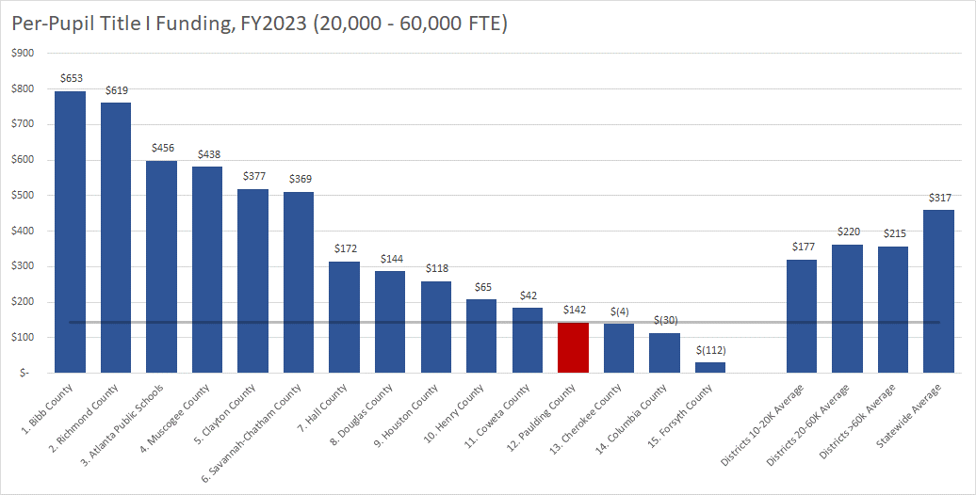
Per-Pupil Federal Title I Funding
Per-Pupil Title I. As of FY2023 and based on overall enrollment, per-pupil Title I funding was $142. This is lower than any comparable group, including the statewide average, which was $317 more per-pupil. Variances to PCSD appear above the columns.
Source: GaDOE, Title I Awards
FY2023
2 | Budget Factors

Slide 28
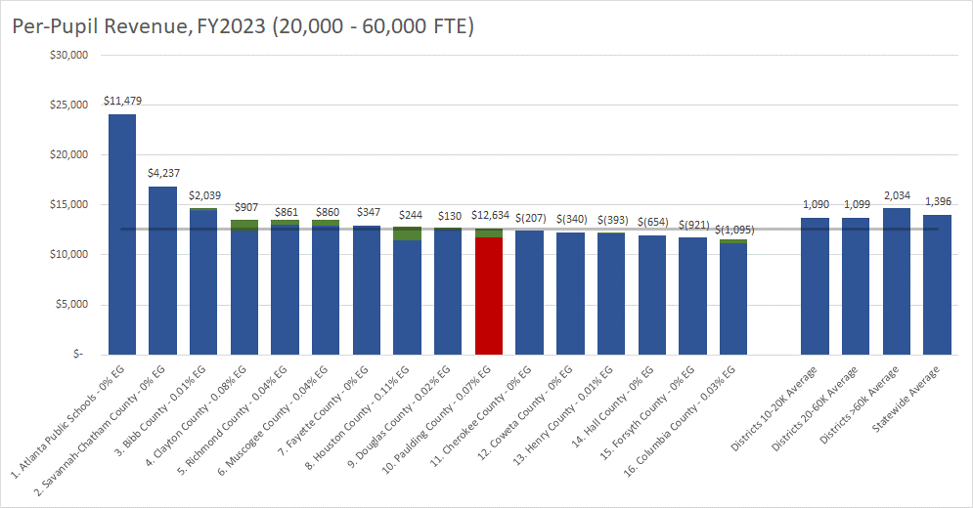
Per-Pupil Revenue: All Sources
Total Per-Pupil Revenue. As of FY2023, total per-pupil revenue was $12,634. Lower than any comparable group, including the statewide average, which was $1,396 more per-pupil. Approximately, $864 or 7.0% was funded through the Equalization Grant (green). Variances to PCSD appear above the columns.
Source: GaDOE School System Revenue/Expenditures Report as of FY2023
FY2023
2 | Budget Factors

Slide 29



Tax and SPLOST Collections
Local and Total Revenue. PCSD currently collects $0.90 for every $1.00 in total revenue per student statewide (average) and $0.74 for every $1.00 in local revenue per student statewide (average).
SPLOST Collections. PCSD currently collects only $0.55 for every $1.00 collected on average by our neighboring school districts, including Cherokee, Cobb, Bartow, and Douglas Counties. Considering Debt Service, PCSD is only $0.41 for every $1.00.
Source: GaDOE School System Revenue/Expenditures Report as of FY2023 and Georgia Department of Revenue Sales Tax Collections June 2022 – July 2023,
2022-2023
Summary Presentation

Slide 30
Organizational Factors Influencing Decisions: Legislative Factors
“As one of the largest, fastest-growing, and low-wealth school districts in Georgia we are highly vulnerable to legislative changes. With 57% of our total revenue coming from state sources, the district is highly susceptible to legislative changes that impact funding, including austerity reductions, Equalization Grant funding, and changes in the Quality Basic Education (QBE) formula. In addition, other legislative actions can have a significant impact on district operations.”
Legislative Factors:
$2,500 raise for QBE funded certified staff (not all certified positions or classified positions)
Additional increase to State Health Benefit Plan employer cost, this is the second year of two-year phase-in for classified employee (ultimately a 11.4% increase)
Increase in QBE funding for SHBP increase for certified staff
4.1% raise for bus drivers and school nurses
$1,000 salary supplement for custodians
School Safety and Security
Changes to property values and homestead exemptions
Engage. Inspire. Prepare.

Slide 31
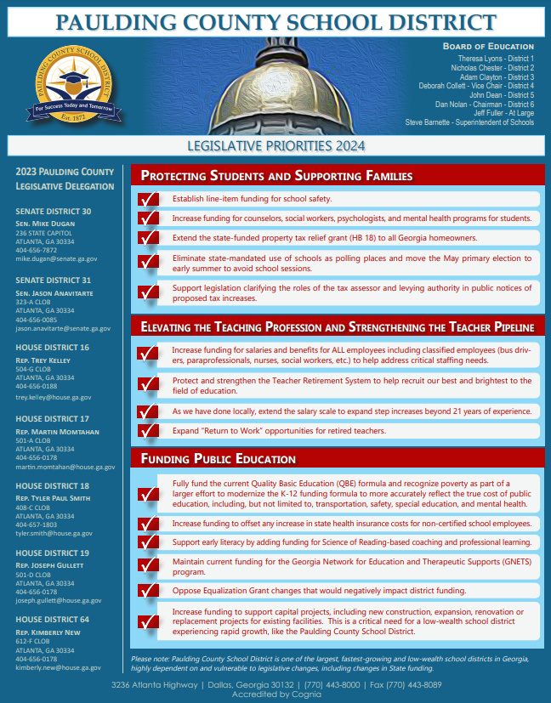
Organizational Factors Influencing Decisions:
Legislative Factors
$2,500 raise for QBE funded certified staff *
Increase to State Health Benefit Plan employer cost for classified staff
Increase in QBE funding for SHBP increase for certified staff
4.1% raise for bus drivers and school nurses*
$1,000 salary supplement for custodians*
School Safety and Security*
Changes to property values and homestead exemptions
* PCSD Priority 2024
Summary Presentation

Slide 32
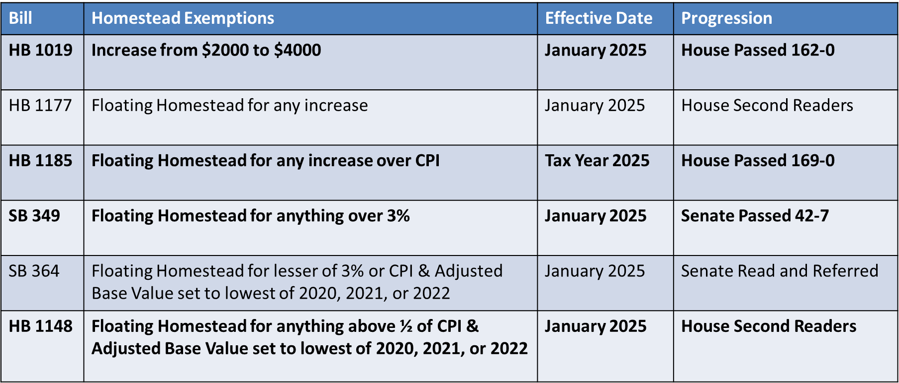
Organizational Factors Influencing Decisions:
Legislative Factors
Summary Presentation

Slide 33
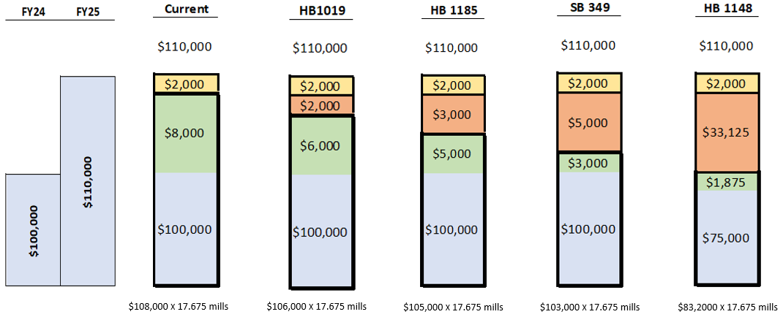
Organizational Factors Influencing Decisions:
Legislative Factors: Homestead Exemptions
Summary Presentation

Slide 34
FY2025 Budget Roadmap
April 9, 2024
Preliminary Revenue, Expenditure, and Allotment Presentation
1 | Timeline

Slide 35
Thank You
Engage. Inspire. Prepare.

Slide 36
Appendix
Engage. Inspire. Prepare.

Slide 37
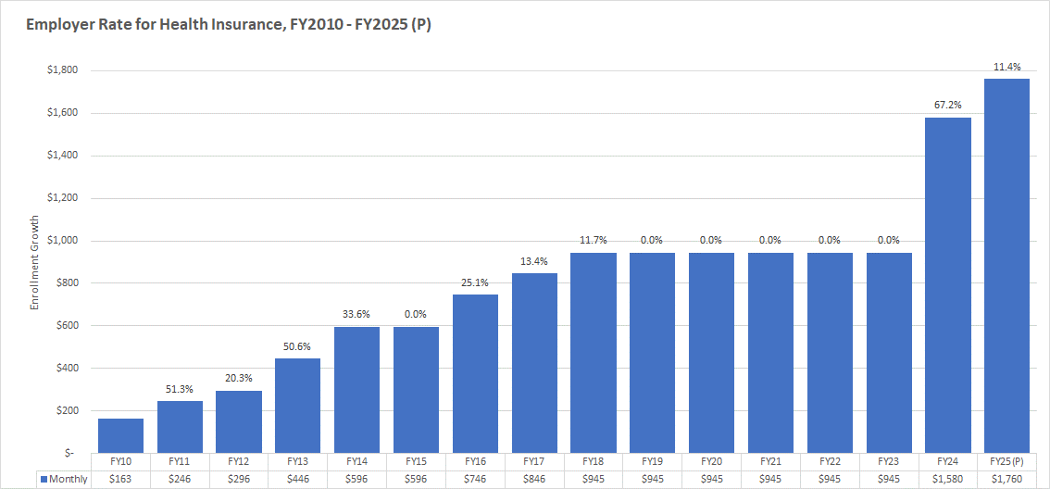
Health Insurance
Health Insurance. FY2025 State Health Benefit Plan employer cost is expected to increase 11.4% to $1,760 per month. QBE funding is increasing for certified employees but there will be a two-year phase-in for classified employees.
FY2010 – FY2025(P)
Appendix

